Slide 1
Unit3: Syntactic Specification of Languages
Parsing techniques

Slide 2
Parsing techniques
Depending on how the parse tree is created
Top-Down Parsing
Construction of the parse tree starts at the root, and proceeds towards the leaves.
Efficient top-down parsers can be easily constructed by hand.
Bottom-Up Parsing aka shift-reduce parsing
Construction of the parse tree starts at the leaves, and proceeds towards the root.
Normally efficient bottom-up parsers are created with the help of some software tools.

Slide 3
Shift-Reduce Parsing
Most common bottom-up parser
Occurs in the analysis of both natural languages and computer languages.
These parsers examine the input tokens and either shift (push) them onto a stack or reduce elements at the top of the stack, replacing a right-hand side by a left-hand side.

Slide 4
Action table
Aka parse table
helps the parser determine what to do next.

Slide 5
Actions
Shift - push token onto stack
Reduce - remove handle from stack and push on corresponding non-terminal
Accept - recognize sentence when stack contains only the distinguished symbol and input is empty
Error - happens when none of the above is possible; means original input was not a sentence.

Slide 6
Algorithm
Start with the sentence to be parsed as the initial sentential form
Until the sentential form is the start symbol do:
Scan through the input until we recognise something that corresponds to the RHS of one of the production rules (this is called a handle)
Apply a production rule in reverse; i.e., replace the RHS of the rule which appears in the sentential form with the LHS of the rule (an action known as a reduction)

Slide 7
Algorithm (Cont.)
Start with an empty stack
"shift" action corresponds to pushing the current input symbol onto the stack
"reduce" action occurs when we have a handle on top of the stack.
To perform the reduction, we pop the handle off the stack and replace it with the terminal on the LHS of the corresponding rule.

Slide 8
Shift-Reduce Parsing: Example
Given the language:
<Expression>--> <Term> | <Term> + <Expression>
<Term>--> <Factor> | <Factor> * <Term>
<Factor>--> [ <Expression> ] | <0…9> | <x…z>
Input String: 2 * [ 1 + 3 ]

Slide 9
Action table: Example
Stack | Input String | Action
() | (2 * [ 1 + 3 ]) | SHIFT
(2) | (* [ 1 + 3 ]) | REDUCE
(<Factor>) | (* [ 1 + 3]) | SHIFT
(<Factor> *) | ([ 1 + 3]) | SHIFT
(<Factor> * [) | (1 + 3]) | SHIFT
(<Factor> * [ 1) | (+ 3]) | REDUCE
(<Factor> * [ <Factor>) | (+ 3]) | REDUCE
(<Factor> * [ <Term>) | (+ 3]) | SHIFT

Slide 10
Action table: Example (Cont.)
(<Factor> * [ <Term> +) | ( 3]) | SHIFT
(<Factor> * [ <Term> + 3) | ( ]) | REDUCE
(<Factor> * [ <Term> + <Factor>) | ( ]) | REDUCE
(<Factor> * [ <Term> + <Term>) | ( ]) | REDUCE
(<Factor> * [ <Term> + <Expression>) | ( ]) | REDUCE
(<Factor> * [ <Expression>) | ( ]) | SHIFT
(<Factor> * [ <Expression> ]) | () | REDUCE

Slide 11
Action table: Example (Cont.)
(<Factor> * <Factor>) | () | REDUCE
(<Factor> * <Term>) | () | REDUCE
(<Term>) | () | REDUCE
(<Expression>) | () | SUCCESS

Slide 12
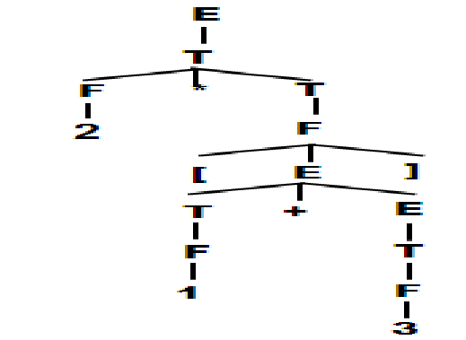
Concrete parse tree: Example

